Slide 1
Chapter 4 - JavaScript
Fundamentals of JavaScript

Slide 2
Why Study JavaScript?
JavaScript is one of the 3 languages all web developers must learn:
HTML to define the content of web pages
CSS to specify the layout of web pages
JavaScript to program the behavior of web pages

Slide 3
Introduction to JavaScript
It is designed to add interactivity to HTML pages
It is used to program the behavior of web pages.
It is a scripting language (a lightweight programming language)
It is an interpreted language (it executes without preliminary compilation)

Slide 4
Introduction to JavaScript cont’d
JavaScript is the default scripting language in HTML and usually embedded directly into HTML pages.
JavaScript is a prototype-based, multi-paradigm, single-threaded, dynamic language,
supporting object-oriented, imperative, and declarative (e.g. functional programming) styles

Slide 5
What can a JavaScript Do?
JavaScript can put dynamic text into an HTML page
JavaScript can react to events
JavaScript can read and write HTML elements
JavaScript can be used to validate data
JavaScript can be used to detect the visitor’s browser
JavaScript can be used to create cookies
Store and retrieve information on the visitor’s computer

Slide 6
JavaScript Where To
The HTML <script> tag is used to insert a JavaScript into an HTML page
<script type=“text/javascript”>
document.write(“Hello World!”)
</script>
Ending statements with a semicolon?
Optional; required when you want to put multiple statements on a single line

Slide 7
JavaScript Where To cont’d…
JavaScript can be inserted within the head, the body, or use external JavaScript file
Functions and code that may execute multiple times is typically placed in the <HEAD>
These are only interpreted when the relevant function or event-handler are called
If you need a script to run as the page loads so that the script generates content in the page, then the script goes in the <body> portion of the document

Slide 8
JavaScript in <head>
myFunction is invoked (called) when Try it button is clicked:
<!DOCTYPE html>
<html>
<head>
<script>
function myFunction() {
document.getElementById("demo").innerHTML = “Welcome to IP course.";
}
</script>
</head>
<body>
<h2>Demo JavaScript in Head</h2>
<p id="demo">Hello World</p>
<button type="button" onclick="myFunction()">Try it</button>
</body>
</html>

Slide 9
JavaScript in <body>
myFunction is invoked (called) when Try it button is clicked:
<!DOCTYPE html>
<html>
<body>
<h2>Demo JavaScript in Body</h2>
<p id="demo">Hello World!</p>
<button type="button" onclick="myFunction()">Try it</button>
<script>
function myFunction() {
document.getElementById("demo").innerHTML = " Welcome to IP course.";
}
</script>
</body>
</html>

Slide 10
External JavaScript
External scripts are practical when the same code is used in many different web pages.
JavaScript files have the file extension .js.
To use an external script, put the name of the script file in the src (source) attribute of a <script> tag:
<script src="myScript.js"></script>
Where myScript.js is an external file given below:
function myFunction() { document.getElementById("demo").innerHTML = "Paragraph changed."; }

Slide 11
External JavaScript cont’d…
JavaScripts are visible in the client browser since they are typically acting only on the client.
To prevent the script itself from being (easily) seen, we can upload our JavaScript from a file:
<script type="text/javascript" src="filename.js" ></script>
External scripts are practical when the same code is used in many different web pages.
JavaScript files have the file extension .js.

Slide 12
External JavaScript Advantages and Referencing
Placing scripts in external files has some advantages:
It separates HTML and JavaScript code
It makes HTML and JavaScript easier to read and maintain
Cached JavaScript files can speed up page loads
To add several script files to one page - use several script tags:
<script src="myScript1.js"></script> <script src="myScript2.js"></script>
An external script can be referenced in 3 different ways:
With a full URL (a full web address) : <script src="https://www.w3schools.com/js/myScript.js"></script>
With a file path (like /js/): <script src="/js/myScript.js"></script>
Without any path: <script src="myScript.js"></script>

Slide 13
JavaScript Display Possibilities
JavaScript can "display" data in different ways:
Writing into an HTML element, using innerHTML.
Writing into the HTML output using document.write().
Writing into an alert box, using window.alert().
Writing into the browser console, using console.log().

Slide 14
Using innerHTML
To access an HTML element, JavaScript uses the document.getElementById(id) method. The id attribute defines the HTML element.
The innerHTML property defines the HTML content:
<p id=“demo”></p>
document.getElementById(“demo”).innerHTML=“Hello World”

Slide 15
Using document.write().
For testing purposes, it is convenient to use document.write():
<!DOCTYPE html>
<html>
<body>
<h1>My First Web Page</h1>
<p>My first paragraph.</p>
<script>
document.write(5 + 6);
</script>
</body>
</html>

Slide 16
Using window.alert() and console.log()
window.alert() is used to display data. You can skip the window keyword.
In JavaScript, the window object is the global scope object, that means that variables, properties, and methods by default belong to the window object.
This also means that specifying the window keyword is optional.
For debugging purposes, you can call the console.log() method in the browser to display data.

Slide 17
Using window.alert() and console.log() cont’d..
<!DOCTYPE html>
<html>
<body>
<h1>My First Web Page</h1>
<p>My first paragraph.</p>
<script>
alert(5 + 6);
Console.log(5+6)
</script>
</body>
</html>

Slide 18
JavaScript Print
JavaScript does not have any print object or print methods.
You cannot access output devices from JavaScript.
The only exception is that you can call the window.print() method in the browser to print the content of the current window.
<!DOCTYPE html> <html> <body> <button onclick="window.print()">Print this page</button> </body> </html>

Slide 19
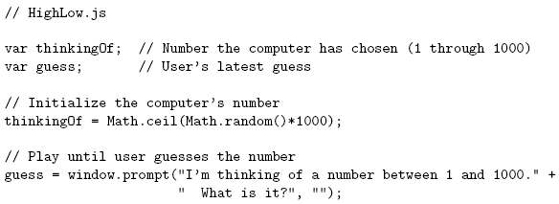
JavaScript Statements
Notice that there is no main() function/method
Comments like Java/C++ (/* */ also allowed)

Slide 20
JavaScript Statements cont’d…
<!DOCTYPE html>
<html>
<body>
<h2>JavaScript Statements</h2>
<p>A <b>JavaScript program</b> is a list of <b>statements</b> to be executed by a computer.</p>
<p id="demo"></p>
<script> // variable declaration
let x, y, z; // Statement 1
x = 5; // Statement 2
y = 6; // Statement 3
z = x + y; // Statement 4
document.getElementById("demo").innerHTML =
"The value of z is " + z + ".";
</script>
</body>
</html>

Slide 21
JavaScript Statements - comments
In HTML, JavaScript programs are executed by the web browser.
JavaScript comments can be used to explain JavaScript code, and to make it more readable.
JavaScript comments can also be used to prevent execution, when testing alternative code.
Adding // in front of a code line changes the code lines from an executable line to a comment.
This example uses // to prevent execution of one of the code lines:
//document.getElementById("myH").innerHTML = "My First Page"; document.getElementById("myP").innerHTML = "My first paragraph.";
JavaScript statements are composed of: Values, Operators, Expressions, Keywords, and Comments.

Slide 22
JavaScript Statements cont’d…...
Variable declarations:
Not required
Data type not specified

Slide 23
Declaring (Creating) JavaScript Variables
Creating a variable in JavaScript is called "declaring" a variable.
You declare a JavaScript variable with the var keyword:
var carName;
After the declaration, the variable has no value (technically it has the value of undefined).
To assign a value to the variable, use the equal sign:
carName = "Volvo";
You can also assign a value to the variable when you declare it:
var carName = "Volvo";
A variable declared without a value will have the value undefined

Slide 24
Display what’s stored in the variable
Example- displaying the value inside an HTML paragraph with id="demo":
<html>
<body>
<h2>JavaScript Variables</h2>
<p>Create a variable, assign a value to it, and display it:</p>
<p id="demo"></p>
<script>
var carName = "Volvo";
document.getElementById("demo").innerHTML = carName;
</script>
</body>
</html>

Slide 25
JavaScript Statements cont’d…
Semi-colons are usually
not required, but always
allowed at statement end

Slide 26
JavaScript Statements cont’d…
Arithmetic operators same as Java/C++

Slide 27
JavaScript Statements cont’d…
String concatenation operator
as well as addition

Slide 28
JavaScript Statements cont’d…
Arguments can be any expressions
Argument lists are comma-separated

Slide 29
JavaScript Statements cont’d…
Object dot notation for method calls as in Java/C++

Slide 30
JavaScript Statements cont’d…
Many control constructs and
use of { } identical to Java/C++

Slide 31
JavaScript Statements cont’d…
Most relational operators
Syntactically same as Java/C++

Slide 32
JavaScript Statements cont’d…
Automatic type conversion:
guess is String, thinkingOf is Number

Slide 33
Variables and types
JavaScript variables have no types
Type is determined dynamically, based on the value stored
The typeof operator can be used to check type of a variable
Declarations are made using the var keyword
Can be implicitly declared, but not advisable
Declarations outside of any function are global
Declarations within a function are local to that function
Variables declared but not initialized have the value undefined

Slide 34
Variables and types cont’d…
Type of a variable is dynamic: depends on the type of data it contains
JavaScript has six data types:
Number
String
Boolean (values true and false)
Object
Null (only value of this type is null)
Undefined (value of newly created variable)
Primitive data types: all but Object

Slide 35
JavaScript Identifiers
Identifiers are names.
In JavaScript, identifiers are used to name variables (and keywords, and functions, and labels).
The rules for legal names are much the same in most programming languages.
In JavaScript, the first character must be a letter, or an underscore (_), or a dollar sign ($).
Subsequent characters may be letters, digits, underscores, or dollar signs.
Numbers are not allowed as the first character.
This way JavaScript can easily distinguish identifiers from numbers.
All JavaScript identifiers are case sensitive.
The variables lastName and lastname, are two different variables:

Slide 36
Naming Variables- Camel Case
Historically, programmers have used different ways of joining multiple words into one variable name:
Underscore:
first_name, last_name, master_card, inter_city.
Upper Camel Case (Pascal Case):
FirstName, LastName, MasterCard, InterCity.
Lower Camel Case:
JavaScript programmers tend to use camel case that starts with a lowercase letter:
firstName, lastName, masterCard, interCity.

Slide 37
Type ...

Slide 38
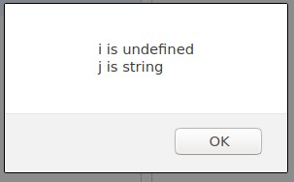
Type ...

Slide 39
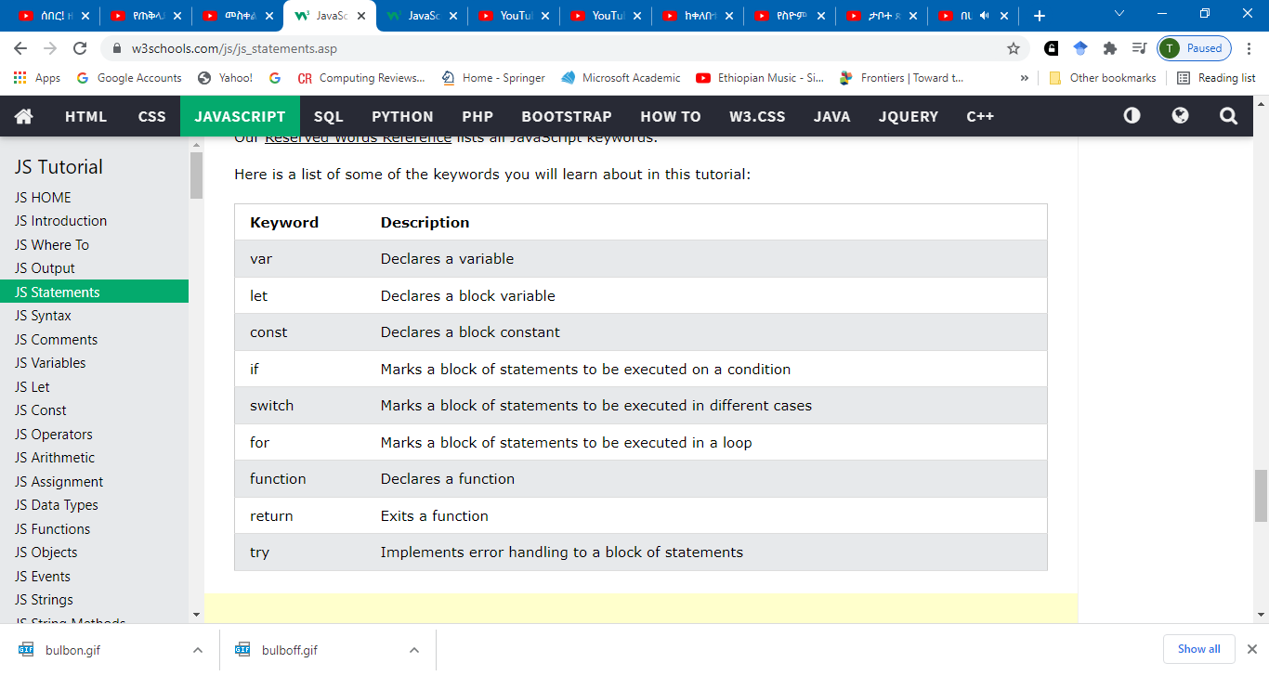
JavaScript Keywords
JavaScript statements often start with a keyword to identify the JavaScript action to be performed.

Slide 40
JavaScript Statements

Slide 41
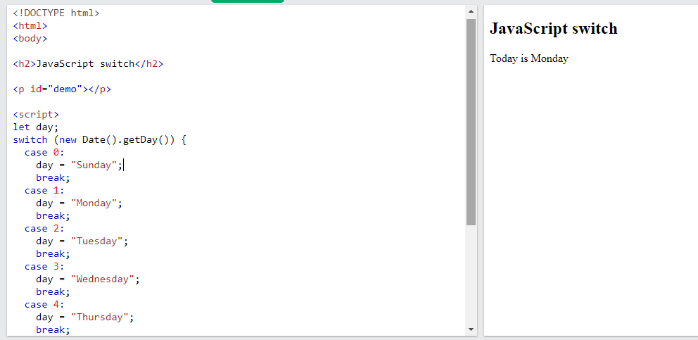
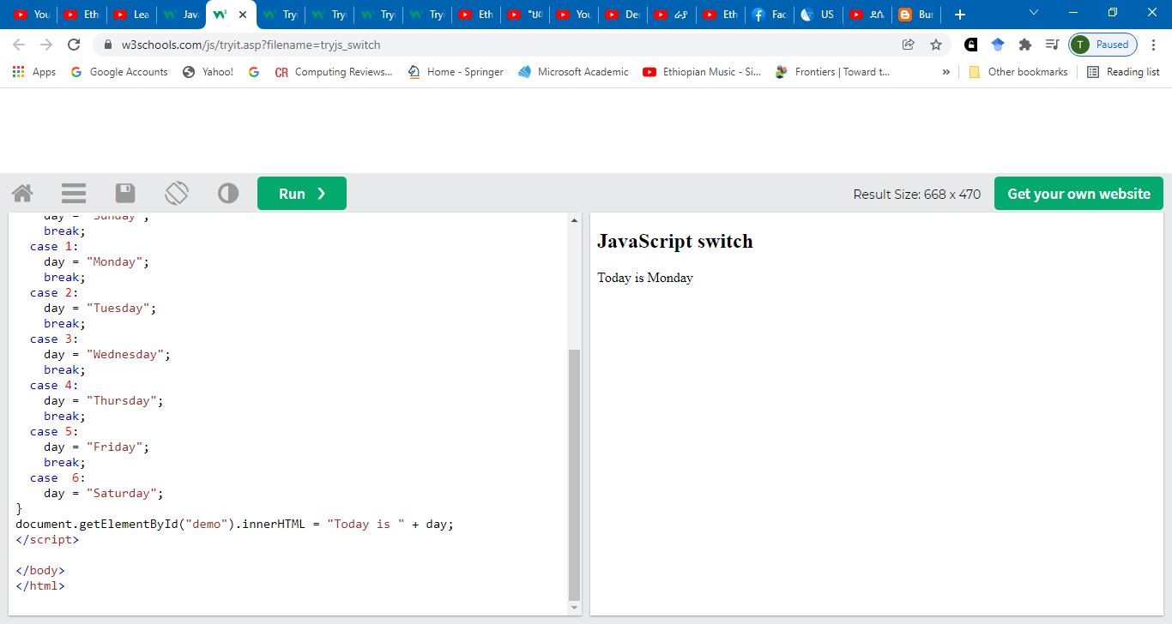

Slide 42
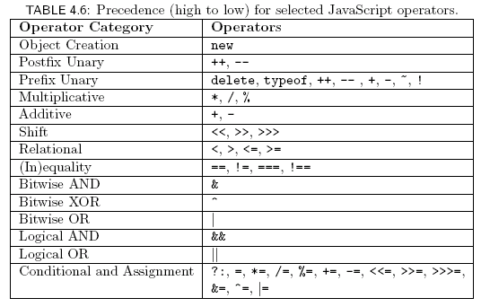
Operators ….

Slide 43
JavaScript Function Syntax
A JavaScript function is defined with the function keyword, followed by a name, followed by parentheses ().
Function names can contain letters, digits, underscores, and dollar signs (same rules as variables).
The parentheses may include parameter names separated by commas:
(parameter1, parameter2, ...)
The code to be executed, by the function, is placed inside curly brackets: {}
function name(parameter1, parameter2, parameter3) {
// code to be executed
}
Function parameters are listed inside the parentheses () in the function definition.
Function arguments are the values received by the function when it is invoked.

Slide 44
JavaScript Functions-Example 1
Declaration always begins with keyword function,
no return type
function oneTo(high)
{
return Math.ceil(Math.random()*high);
}
thinkingOf=oneTo(10000);

Slide 45
JavaScript Functions-Example 2
<!DOCTYPE html>
<html>
<body>
<h2>JavaScript Functions</h2>
<p>This example calls a function which performs a calculation, and returns the result:</p>
<p id="demo"></p>
<script>
function myFunction(p1, p2) {
return p1 * p2;
}
document.getElementById("demo").innerHTML = myFunction(4, 3);
</script>
</body>
</html>

Slide 46
JavaScript Functions-Example 3
<!DOCTYPE html>
<html>
<body>
<h2>JavaScript Functions</h2>
<p>This example calls a function which performs a calculation and returns the result:</p>
<p id="demo"></p>
<script>
var x = myFunction(4, 3);
document.getElementById("demo").innerHTML = x;
function myFunction(a, b) {
return a * b;
}
</script>
</body>
</html>

Slide 47
JavaScript Functions-Example 4
<!DOCTYPE html>
<html>
<body>
<h2>JavaScript Functions</h2>
<p>Outside myFunction() carName is undefined.</p>
<p id="demo1"></p>
<p id="demo2"></p>
<script>
myFunction();
function myFunction() {
let carName = "Volvo";
document.getElementById("demo1").innerHTML =
typeof carName + " " + carName;
}
document.getElementById("demo2").innerHTML =
typeof carName;
</script>
</body>
</html>

Slide 48
JavaScript Values
The JavaScript syntax defines two types of values:
Fixed values
Variable values
Fixed values are called Literals.
Variable values are called Variables.
In a programming language, variables are used to store data values.
JavaScript uses the keywords var, let and const to declare variables.
An equal sign is used to assign values to variables.
In this example, x is defined as a variable. Then, x is assigned (given) the value 6:
let x; x = 6;
JavaScript keywords are used to identify actions to be performed. The let keyword tells the browser to create variables.

Slide 49
Local vs global

Slide 50
Arrays
JavaScript support numbered indexing
Elements can be objects
myArray[0]=date.now
Do not support associative array //view objects
var cars = ["Saab", "Volvo", "BMW"];//create cars[0] = "Opel";//change //cars.push(“vitz”);
document.getElementById("demo").innerHTML = cars[0];//acess

Slide 51
Working with Array- For loop
<script>
var fruits, text, fLen, i;
fruits = ["Banana", "Orange", "Apple", "Mango"];
fLen = fruits.length;
text = "<ul>";
for (i = 0; i < fLen; i++) {
text += "<li>" + fruits[i] + "</li>";
}
text += "</ul>";
document.getElementById("demo").innerHTML = text;
</script>
<!DOCTYPE html>
<html>
<body>
<h2>JavaScript Arrays</h2>
<p>The best way to loop through an array is using a standard for loop:</p>
<p id="demo"></p>
</body>
</html>

Slide 52
Objects
All JavaScript values, except primitives, are objects.
Objects are variables too.
But objects can contain many values.
The values are written as name : value pairs (name and value separated by a colon).
var person = {firstName:"John", lastName:"Doe", age:50, eyeColor:"blue"};

Slide 53
Using JavaScript Objects
The HTML DOM is a standard object model and programming interface for HTML.
It defines:
The HTML elements as objects
The properties of all HTML elements
The methods to access all HTML elements
The events for all HTML elements

Slide 54
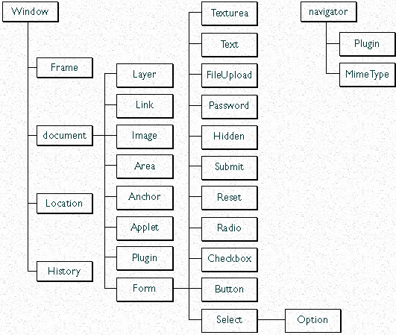
HTML DOM Structure
When you load a document in your web browser, it creates a number of JavaScript objects
These objects exist in a hierarchy that reflects the structure of the HTML page

Slide 55
What is the HTML DOM?
The HTML DOM is a standard object model and programming interface for HTML. It defines:
The HTML elements as objects
The properties of all HTML elements
The methods to access all HTML elements
The events for all HTML elements
The HTML DOM is a standard for how to get, change, add, or delete HTML elements.

Slide 56
With the object model
JavaScript gets all the power it needs to create dynamic HTML:
JavaScript can change all the HTML elements in the page
JavaScript can change all the HTML attributes in the page
JavaScript can change all the CSS styles in the page
JavaScript can remove existing HTML elements and attributes
JavaScript can add new HTML elements and attributes
JavaScript can react to all existing HTML events in the page
JavaScript can create new HTML events in the page

Slide 57
JavaScript HTML DOM Document
The document object represents your web page.
If you want to access any element in an HTML page, you always start with accessing the document object.

Slide 58
JavaScript HTML DOM Document
The HTML DOM document object is the owner of all other objects in your web page.
The HTML DOM Document Object represents your web page.
If you want to access any element in an HTML page, you always start with accessing the document object.
HTML DOM methods are actions you can perform (on HTML Elements).
HTML DOM properties are values (of HTML Elements) that you can set or change.
In the DOM, all HTML elements are defined as objects.
The programming interface is the properties and methods of each object.
A property is a value that you can get or set (like changing the content of an HTML element).
A method is an action you can do (like add or deleting an HTML element).

Slide 59
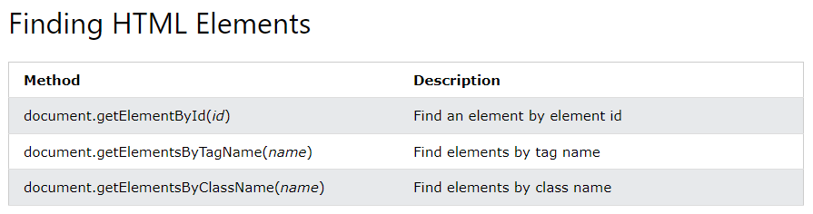
JavaScript HTML DOM Document
Some examples of how you can use the document object to access and manipulate HTML:

Slide 60
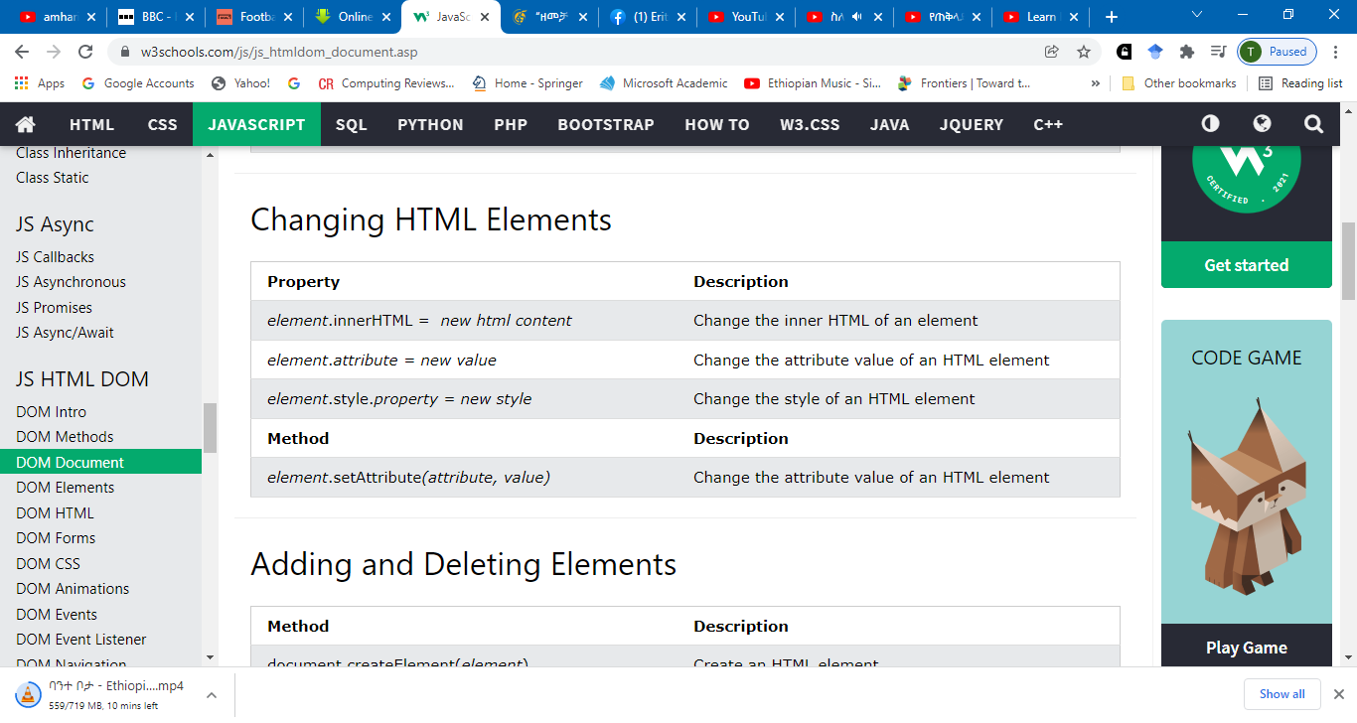
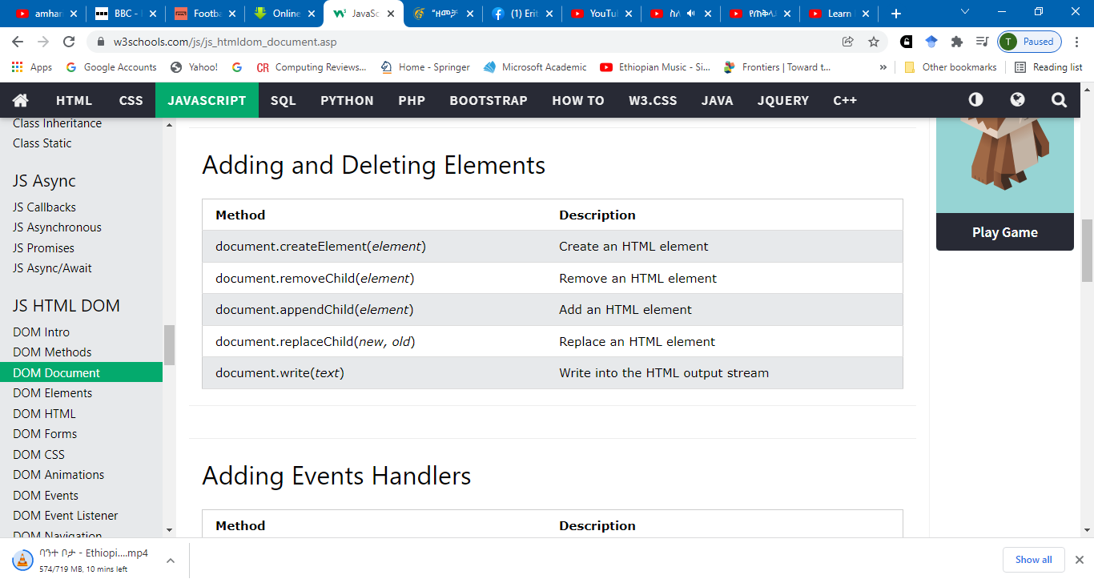

Slide 61
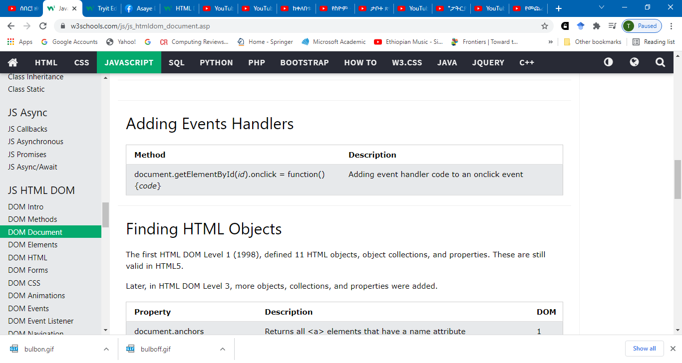
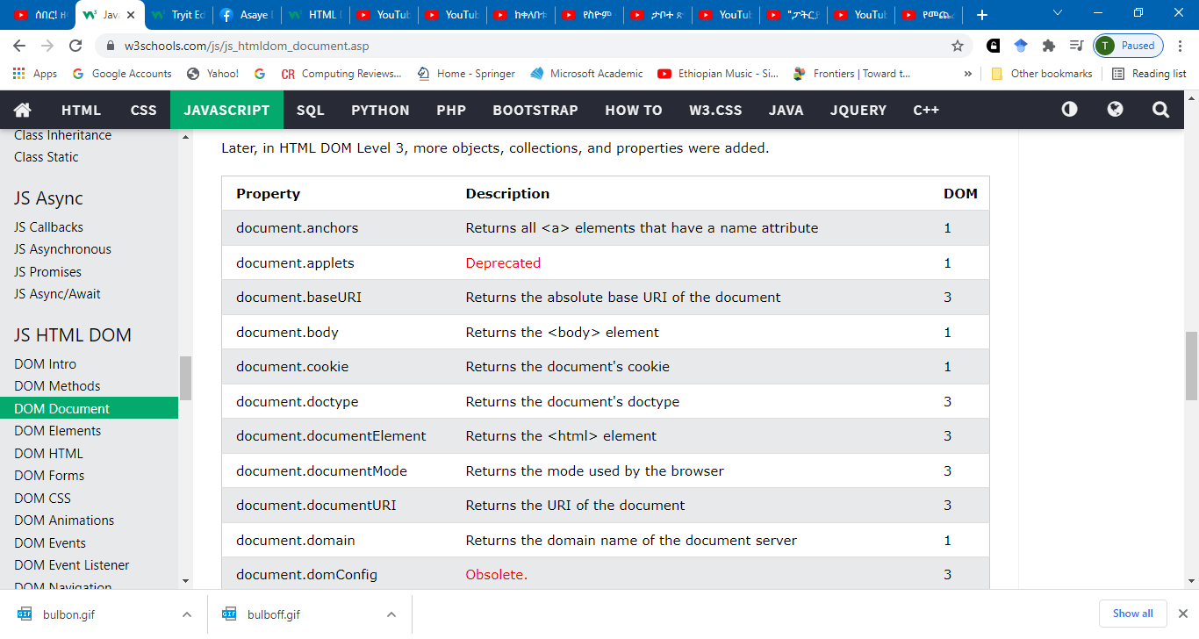
JavaScript HTML DOM Document cont’d…

Slide 62
JavaScript Can Change HTML Content
One of many JavaScript HTML methods is getElementById().
The example below "finds" an HTML element (with id="demo"), and changes the element content (innerHTML) to "Hello JavaScript":
<!DOCTYPE html>
<html>
<body>
<h2>What Can JavaScript Do?</h2>
<p id="demo">JavaScript can change HTML content.</p>
<button type="button" onclick='document.getElementById("demo").innerHTML = "Hello JavaScript!"'>Click Me!</button>
</body>
</html>

Slide 63
JavaScript Can Change HTML Attribute Values
To change the value of the src (source) attribute of an <img> tag:
<!DOCTYPE html>
<html>
<body>
<h2>What Can JavaScript Do?</h2>
<p>JavaScript can change HTML attribute values.</p>
<p>In this case JavaScript changes the value of the src (source) attribute of an image.</p>
<button onclick="document.getElementById('myImage').src='pic_bulbon.gif'">Turn on the light</button>
<img id="myImage" src="pic_bulboff.gif" style="width:100px">
<button onclick="document.getElementById('myImage').src='pic_bulboff.gif'">Turn off the light</button>
</body>
</html>

Slide 64
JavaScript Can Change HTML Styles (CSS)
<!DOCTYPE html>
<html>
<body>
<h2> What Can JavaScript Do? </h2>
<p id="demo"> JavaScript can change the style of an HTML element. </p>
<button type="button” onclick="document.getElementById('demo').style.fontSize='35px'">Click Me!</button>
</body>
</html>

Slide 65
JavaScript Can Hide HTML Elements
Hiding HTML elements can be done by changing the display style:
<!DOCTYPE html>
<html>
<body>
<h2>What Can JavaScript Do?</h2>
<p id="demo">JavaScript can hide HTML elements.</p>
<button type="button" onclick="document.getElementById('demo').style.display='none'">Click Me!</button>
</body>
</html>

Slide 66
JavaScript Can Show HTML Elements
Showing hidden HTML elements can also be done by changing the display style:
<!DOCTYPE html>
<html>
<body>
<h2>What Can JavaScript Do?</h2>
<p>JavaScript can show hidden HTML elements.</p>
<p id="demo" style="display:none">Hello JavaScript!</p>
<button type="button" onclick="document.getElementById('demo').style.display='block'">Click Me!</button>
</body>
</html>

Slide 67
Finding HTML Elements by Tag Name
<!DOCTYPE html>
<html>
<body>
<h2>JavaScript HTML DOM</h2>
<p>Finding HTML Elements by Tag Name.</p>
<p>This example demonstrates the <b>getElementsByTagName</b> method.</p>
<p id="demo"></p>
<script>
const element = document.getElementsByTagName("p");
document.getElementById("demo").innerHTML = 'The text in first paragraph (index 0) is: ' + element[0].innerHTML;
</script>
</body>
</html>

Slide 68
Finding HTML Elements by Tag Name cont’d…
<!DOCTYPE html>
<html>
<body>
<h2>JavaScript HTML DOM</h2>
<div id="main">
<p>Finding HTML Elements by Tag Name</p>
<p>This example demonstrates the <b>getElementsByTagName</b> method.</p>
</div>
<p id="demo"></p>
<script>
const x = document.getElementById("main");
const y = x.getElementsByTagName("p");
document.getElementById("demo").innerHTML =
'The first paragraph (index 0) inside "main" is: ' + y[0].innerHTML;
</script>
</body>
</html>

Slide 69
Finding HTML Elements by CSS Selectors
If you want to find all HTML elements that match a specified CSS selector (id, class names, types, attributes, values of attributes, etc), use the querySelectorAll() method.
<!DOCTYPE html>
<html>
<body>
<h2>JavaScript HTML DOM</h2>
<p>Finding HTML Elements by Query Selector</p>
<p class="intro">Hello World!.</p>
<p class="intro">This example demonstrates the <b>querySelectorAll</b> method.</p>
<p id="demo"></p>
<script>
const x = document.querySelectorAll("p.intro");
document.getElementById("demo").innerHTML =
'The first paragraph (index 0) with class="intro" is: ' + x[0].innerHTML;
</script>
</body>
</html>

Slide 70
Finding HTML Elements by HTML Object Collections
This example finds the form element with id="frm1", in the forms collection, and displays all element values:
<!DOCTYPE html>
<html>
<body>
<h2>JavaScript HTML DOM</h2>
<p>Finding HTML Elements Using <b>document.forms</b>.</p>
<form id="frm1" action="/action_page.php">
First name: <input type="text" name="fname" value="Donald"><br>
Last name: <input type="text" name="lname" value="Duck"><br><br>
<input type="submit" value="Submit">
</form>
<p>These are the values of each element in the form:</p>
<p id="demo"></p>
<script>
const x = document.forms["frm1"];
let text = "";
for (let i = 0; i < x.length ;i++) {
text += x.elements[i].value + "<br>";
}
document.getElementById("demo").innerHTML = text;
</script>
</body>
</html>

Slide 71
JavaScript Events
HTML events are "things" that happen to HTML elements.
When JavaScript is used in HTML pages, JavaScript can "react" on these events.
An HTML event can be something the browser does, or something a user does.
Here are some examples of HTML events:
An HTML web page has finished loading
An HTML input field was changed
An HTML button was clicked
JavaScript lets you execute code when events are detected.
HTML allows event handler attributes, with JavaScript code, to be added to HTML elements. With single quotes:
<element event='some JavaScript'>

Slide 72
HTML event- Adding onclick attribute to a <button> element:
<!DOCTYPE html>
<html>
<body>
<button onclick="document.getElementById('demo').innerHTML=Date()"> The time is?
</button>
<p id="demo"></p>
</body>
</html>
The above JavaScript code changes the content of the element with id="demo".

Slide 73
HTML Events-cont’d…
<!DOCTYPE html>
<html>
<body>
<h2>JavaScript HTML Events</h2>
<p>Click the button to display the date.</p>
<button onclick="displayDate()">The time is?</button>
<script>
function displayDate()
{
document.getElementById("demo").innerHTML = Date();
}
</script>
<p id="demo"></p>
</body>
</html>

Slide 74
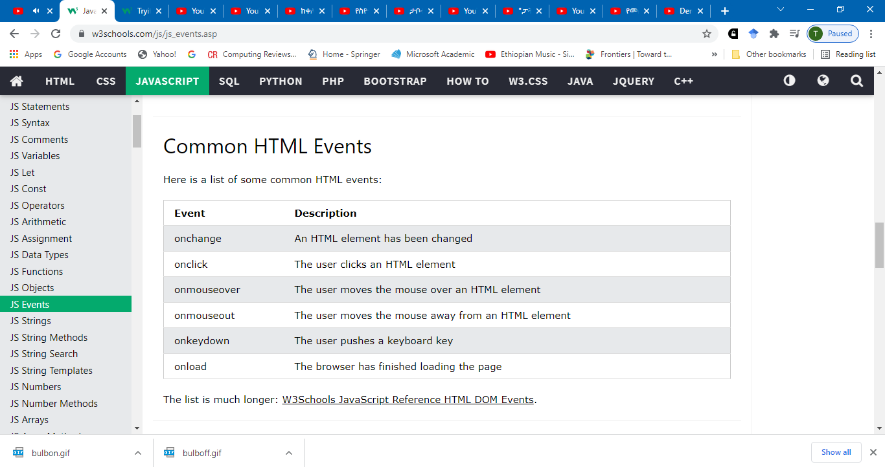
Common HTML Events

Slide 75
HTML Events-cont’d…
Many different methods can be used to let JavaScript work with events:
HTML event attributes can execute JavaScript code directly
HTML event attributes can call JavaScript functions
You can assign your own event handler functions to HTML elements
You can prevent events from being sent or being handled
And more ...

Slide 76
HTML Events-Example
<!DOCTYPE html>
<html>
<body>
<h2>JavaScript HTML Events</h2>
<h2 onclick="changeText(this)">Click on this text!</h2>
<script>
function changeText(id) {
id.innerHTML = “Hello students!";
}
</script>
</body>
</html>

Slide 77
HTML Events-Example
<!DOCTYPE html>
<html>
<body>
<h2>JavaScript HTML Events</h2>
<p>Click "Try it" to execute the displayDate() function.</p>
<button id="myBtn">Try it</button>
<p id="demo"></p>
<script>
document.getElementById("myBtn").onclick = displayDate;
function displayDate()
{
document.getElementById("demo").innerHTML= Date();
}
</script>
</body>
</html>

Slide 78
The onchange Event
<!DOCTYPE html>
<html>
<body>
<h2>JavaScript HTML Events</h2>
Enter your name: <input type="text" id="fname" onchange="upperCase()">
<p>When you leave the input field, a function is triggered which transforms the input text to upper case.</p>
<script>
function upperCase() {
const x = document.getElementById("fname");
x.value = x.value.toUpperCase();
}
</script>
</body>
</html>

Slide 79
The onmouseover and onmouseout Events
<!DOCTYPE html>
<html>
<body>
<div onmouseover="mOver(this)" onmouseout="mOut(this)"
style="background-color:#D94A38;width:120px;height:20px;padding:40px;">
Mouse Over Me</div>
<script>
function mOver(obj) {
obj.innerHTML = "Thank You"
}
function mOut(obj) {
obj.innerHTML = "Mouse Over Me"
}
</script>
</body>
</html>

Slide 80
JavaScript HTML DOM EventListener
<!DOCTYPE html>
<html>
<body>
<h2>JavaScript addEventListener()</h2>
<p>This example uses the addEventListener() method to attach a click event to a button.</p>
<button id="myBtn">Try it</button>
<p id="demo"></p>
<script>
document.getElementById("myBtn").addEventListener("click", displayDate);
function displayDate() {
document.getElementById("demo").innerHTML = Date();
}
</script>
</body>
</html>

Slide 81
<!DOCTYPE html>
<html>
<body>
<h2>JavaScript addEventListener()</h2>
<p>This example uses the addEventListener() method to attach a click event to a button.</p>
<button id="myBtn">Try it</button>
<script>
document.getElementById("myBtn").addEventListener("click", function() {
alert("Hello World!");
});
</script>
</body>
</html>

Slide 82
<!DOCTYPE html>
<html>
<body>
<h2>JavaScript addEventListener()</h2>
<p>This example uses the addEventListener() method to add many events on the same button.</p>
<button id="myBtn">Try it</button>
<p id="demo"></p>
<script>
var x = document.getElementById("myBtn");
x.addEventListener("mouseover", myFunction);
x.addEventListener("click", mySecondFunction);
x.addEventListener("mouseout", myThirdFunction);
function myFunction() {
document.getElementById("demo").innerHTML += "Moused over!<br>";
}
function mySecondFunction() {
document.getElementById("demo").innerHTML += "Clicked!<br>";
}
function myThirdFunction() {
document.getElementById("demo").innerHTML += "Moused out!<br>";
}
</script>
</body>
</html>

Slide 83
Form Validation
<!DOCTYPE html>
<html>
<head>
<script>
function validateForm() {
let x = document.forms["myForm"]["fname"].value;
if (x == "") {
alert("Name must be filled out");
return false;
}
}
</script>
</head>

Slide 84
Add an Event Handler to the window Object
<!DOCTYPE html>
<html>
<body>
<h2>JavaScript addEventListener()</h2>
<p>This example uses the addEventListener() method on the window object.</p>
<p>Try resizing this browser window to trigger the "resize" event handler.</p>
<p id="demo"></p>
<script>
window.addEventListener("resize", function(){
document.getElementById("demo").innerHTML = Math.random();
});
</script>
</body>
</html>

Slide 85
<!DOCTYPE html>
<html>
<body>
<h2>JavaScript HTMLDOM</h2>
<p>Displaying document.body</p>
<p id="demo"></p>
<script>
document.getElementById("demo").innerHTML = document.body.innerHTML;
</script>
</body>
</html>

Slide 86
<!DOCTYPE html>
<html>
<body>
<h2>JavaScript HTMLDOM</h2>
<p>Displaying document.documentElement</p>
<p id="demo"></p>
<script>
document.getElementById("demo").innerHTML = document.documentElement.innerHTML;
</script>
</body>
</html>

Slide 87
Creating New HTML Elements (Nodes)
<!DOCTYPE html>
<html>
<body>
<h2>JavaScript HTML DOM</h2>
<p>Add a new HTML Element.</p>
<div id="div1">
<p id="p1">This is a paragraph.</p>
<p id="p2">This is another paragraph.</p>
</div>
<script>
const para = document.createElement("p");
const node = document.createTextNode("This is new.");
para.appendChild(node);
const element = document.getElementById("div1");
element.appendChild(para);
</script>
</body>
</html>

Slide 88
Creating new HTML Elements - insertBefore()
<!DOCTYPE html>
<html>
<body>
<h2>JavaScript HTML DOM</h2>
<p>Add a new HTML Element.</p>
<div id="div1">
<p id="p1">This is a paragraph.</p>
<p id="p2">This is another paragraph.</p>
</div>
<script>
const para = document.createElement("p");
const node = document.createTextNode("This is new.");
para.appendChild(node);
const element = document.getElementById("div1");
const child = document.getElementById("p1");
element.insertBefore(para,child);
</script>
</body>
</html>

Slide 89
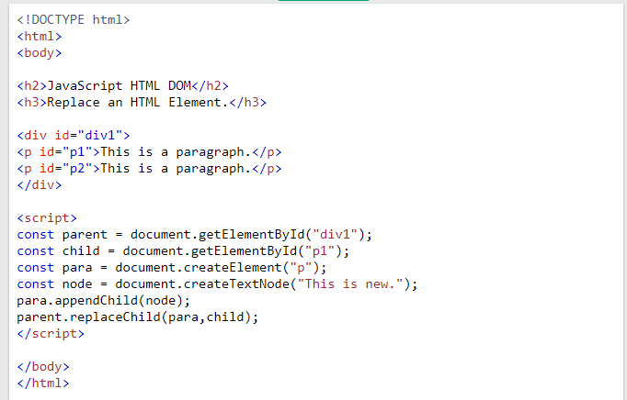
Replacing HTML Elements

Slide 90
Form Validation cont’d…
<body>
<h2>JavaScript Validation</h2>
<form name="myForm" action="/action_page.php" onsubmit="return validateForm()" method="post">
Name: <input type="text" name="fname">
<input type="submit" value="Submit">
</form>
</body>
</html>

Slide 91
Data Validation
Data validation is the process of ensuring that user input is clean, correct, and useful.
Typical validation tasks are:
has the user filled in all required fields?
has the user entered a valid date?
has the user entered text in a numeric field?
The purpose of data validation is to ensure correct user input.
Validation can be defined by many different methods, and deployed in many different ways.
Server side validation is performed by a web server, after input has been sent to the server.
Client side validation is performed by a web browser, before input is sent to a web server.

Slide 92
HTML Constraint Validation
HTML5 introduced a new HTML validation concept called constraint validation.
HTML constraint validation is based on:
Constraint validation HTML Input Attributes
Constraint validation CSS Pseudo Selectors
Constraint validation DOM Properties and Methods

Slide 93
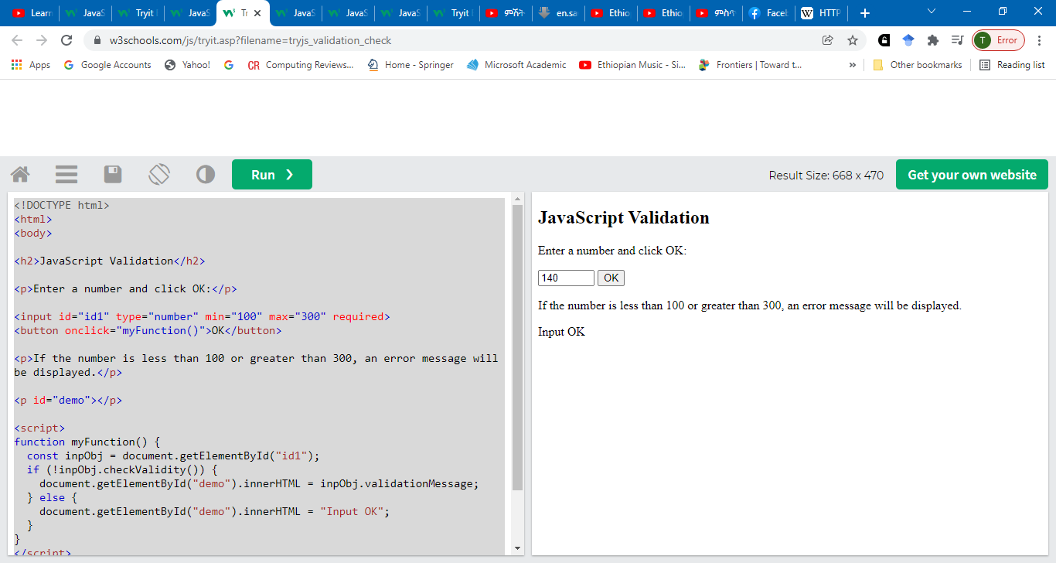

Slide 94
Validation
if(document.getElementById('summer').checked)
{
document.write("Summer radio button is selected");
}
else
{
document.write("Summer radio button is not selected");
}

Slide 95
Single threaded processes contain the execution of instructions in a single sequence. In other words, one command is processes at a time.
The opposite of single threaded processes are multithreaded processes. These processes allow the execution of multiple parts of a program at the same time. These are lightweight processes available within the process.
Multithreaded Processes Implementation
Multithreaded processes can be implemented as user-level threads or kernel-level threads. Details about these are provided using the following diagram −

Slide 96
User-level ThreadsThe user-level threads are implemented by users and the kernel is not aware of the existence of these threads. It handles them as if they were single-threaded processes. User-level threads are small and much faster than kernel level threads. Also, there is no kernel involvement in synchronization for user-level threads.
Kernel-level ThreadsKernel-level threads are handled by the operating system directly and the thread management is done by the kernel. The context information for the process as well as the process threads is all managed by the kernel. Because of this, kernel-level threads are slower than user-level threads.

Slide 97
Advantages of Multithreaded Processes
Some of the advantages of multithreaded processes are given as follows −
All the threads of a process share its resources such as memory, data, files etc. A single application can have different threads within the same address space using resource sharing.
It is more economical to use threads as they share the process resources. Comparatively, it is more expensive and time consuming to create processes as they require more memory and resources.
Program responsiveness allows a program to run even if part of it is blocked using multithreading. This can also be done if the process is performing a lengthy operation.
In a multiprocessor architecture, each thread can run on a different processor in parallel using multithreading. This increases concurrency of the system. This is in direct contrast to a single processor system, where only one process or thread can run on a processor at a time.

Slide 98
Disadvantages of Multithreaded Processes
Some of the disadvantages of multithreaded processes are given as follows −
Multithreaded processes are quite complicated. Coding for these can only be handled by expert programmers.
It is difficult to handle concurrency in multithreaded processes. This may lead to complications and future problems.
Identification and correction of errors is much more difficult in multithreaded processes as compared to single threaded processes.

